Slide 1
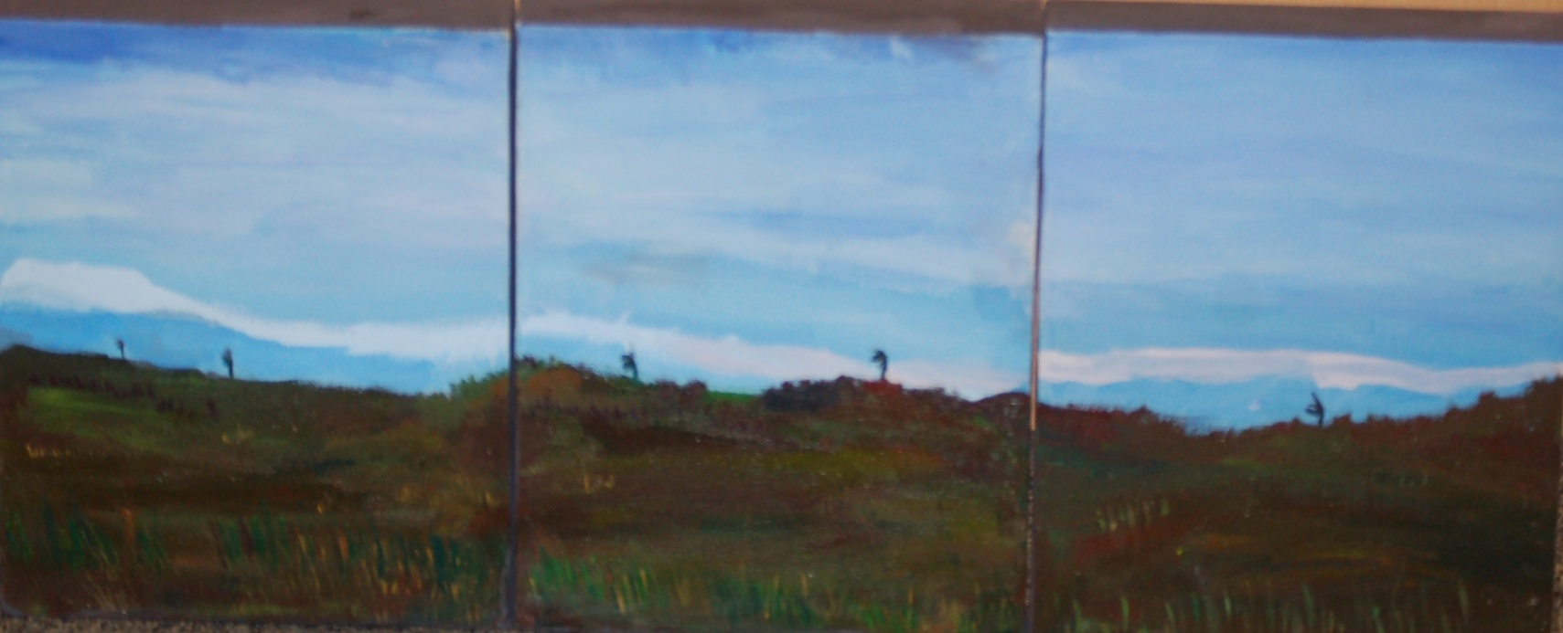
Future House Open Evening
10 December 2014
Winner of the Primary Age Range
Umir Khan, Year 6 of Peel Park Primary School
‘Bradford Landscape’

Slide 2
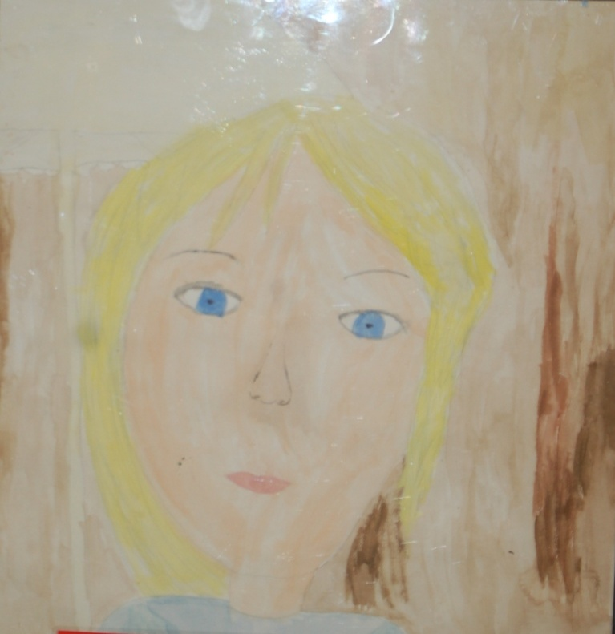
Future House Open Evening
10 December 2014
Runner Up Primary Age Range
Greer Mitchell, Year 5 of St John The Evangelist Catholic Primary School
‘Untitled’

Slide 3
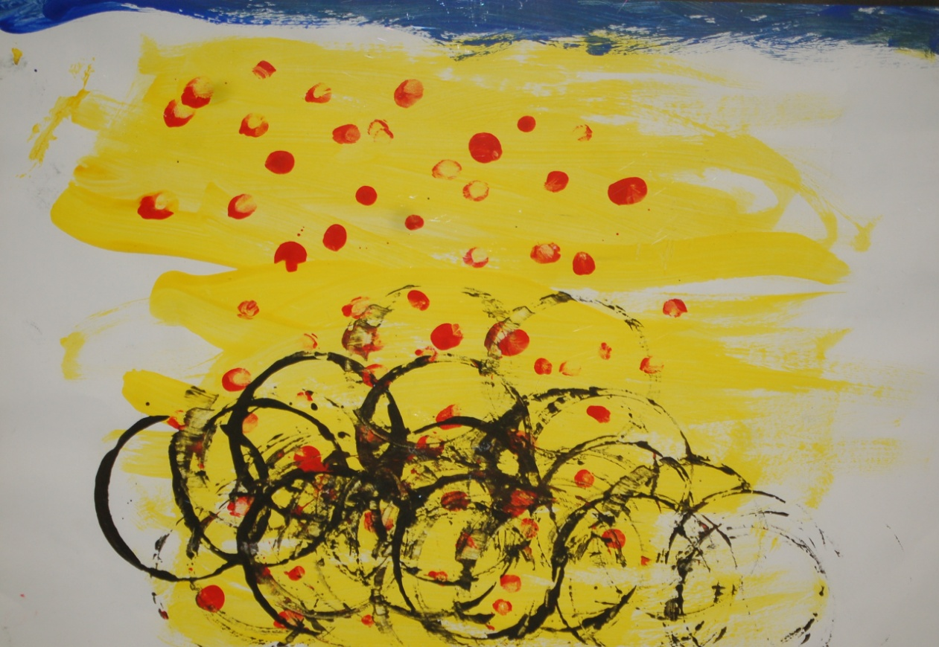
Future House Open Evening
10 December 2014
Runner Up Primary Age Range
Kyla Harris, Year 1 of Myrtle Park Primary School
‘Abstract Cyclists’

Slide 4
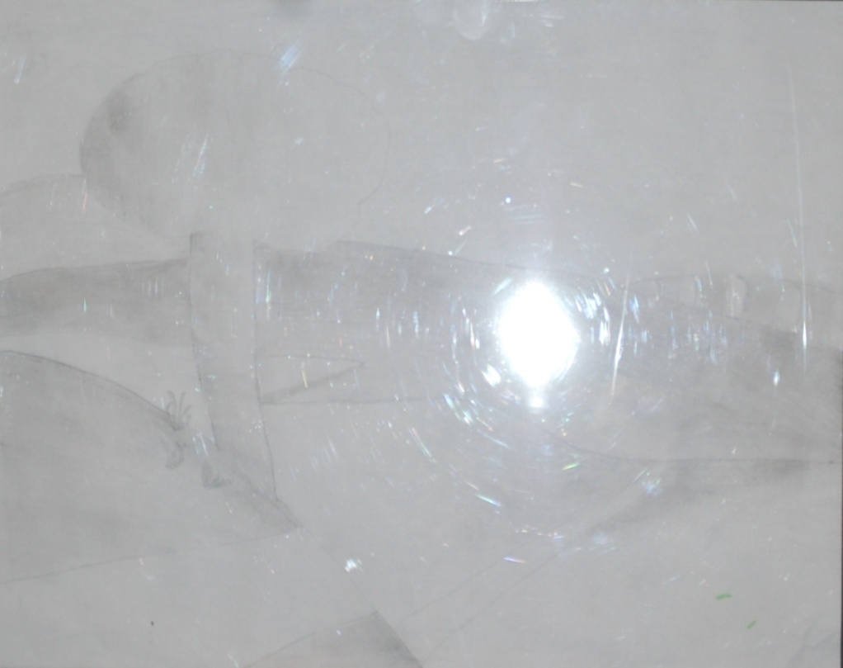
Future House Open Evening
10 December 2014
Runner Up Primary Age Range
Jake C, Year 5 of St Joseph’s Catholic Primary Keighley
‘Rural Landscape’

Slide 5
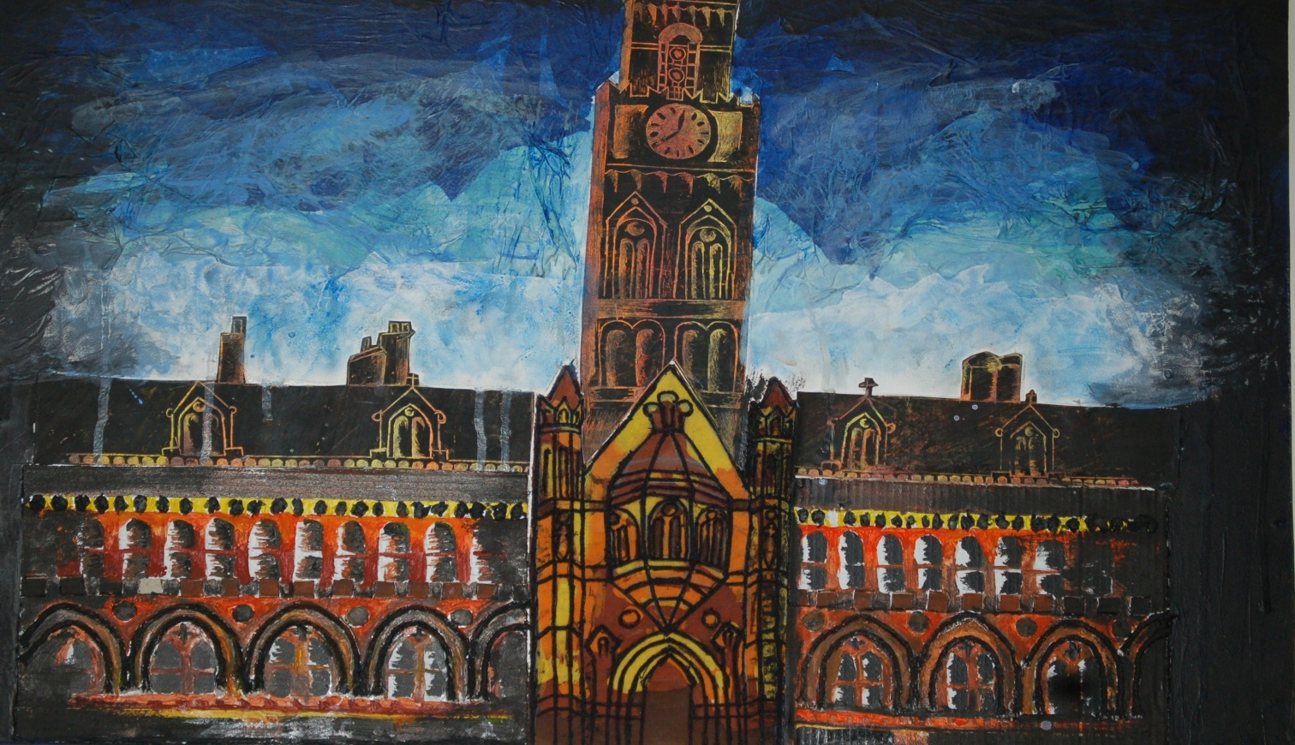
Future House Open Evening
10 December 2014
Winner Seconary Age Range
Saira Shehzadi, Year 12 of Belle Vue Girls’ School
‘Bradford Landscape’

Slide 6
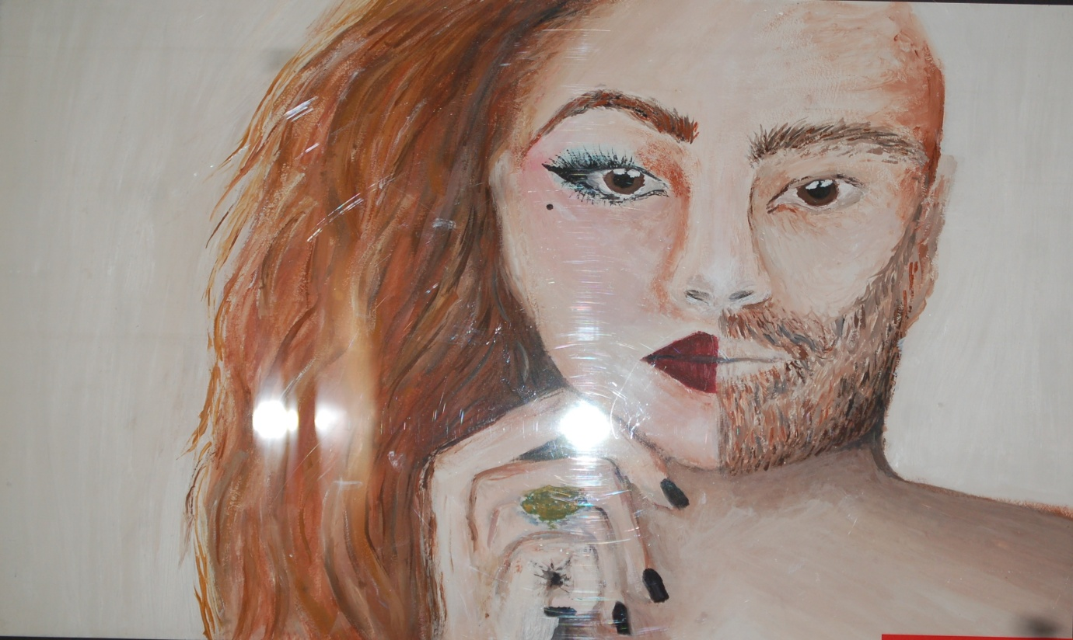
Future House Open Evening
10 December 2014
Runner Up Secondary Age Range
Beth Jackson, Year 11 of St Joseph’s Catholic College
‘GCSE Exam’

Slide 7
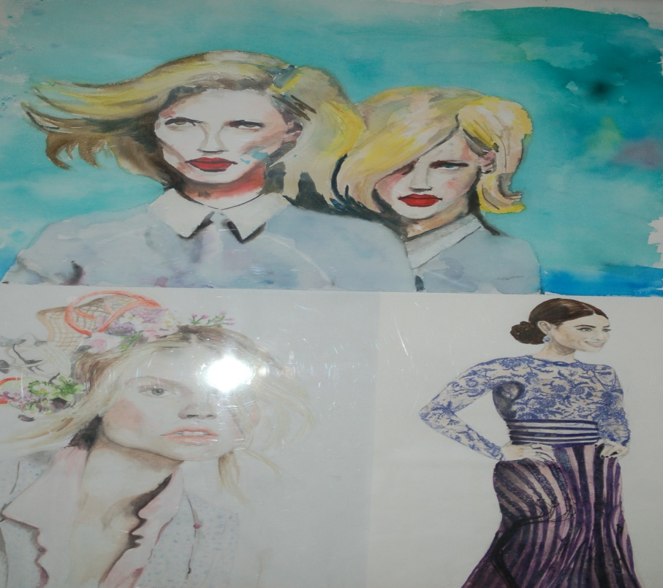
Future House Open Evening
10 December 2014
Runner Up Secondary Age Range
Charlotte Johnson, Year 13 of St Bede’s Catholic College
‘Identity’

Slide 8
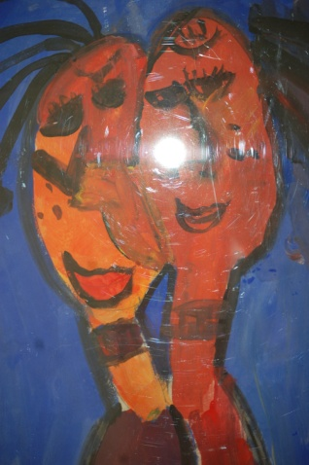
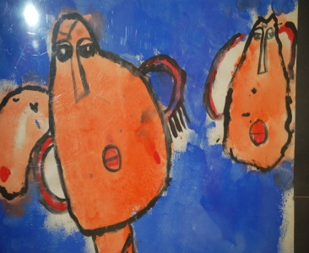
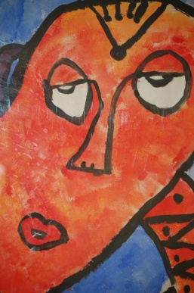
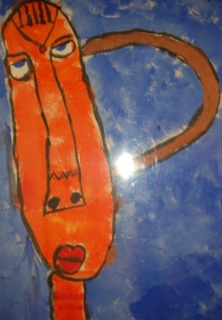
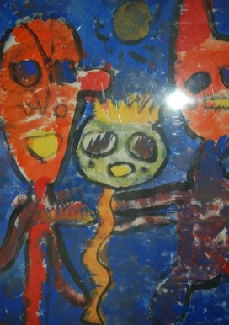
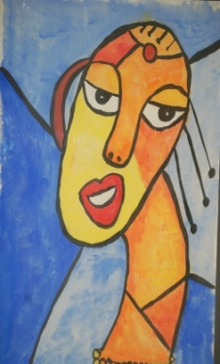
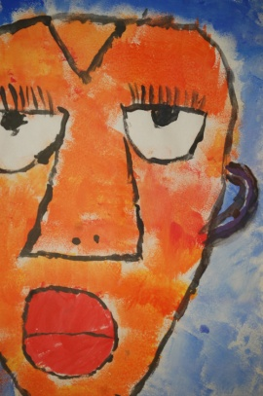
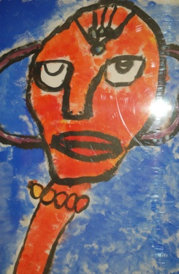
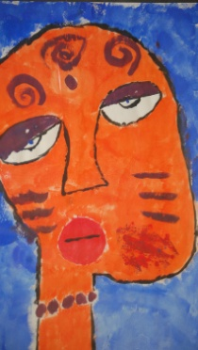
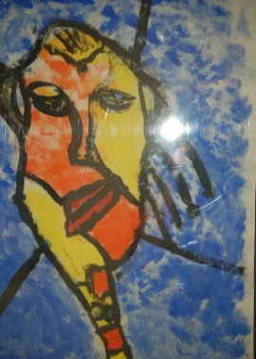
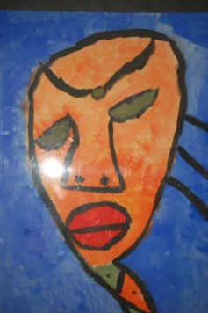
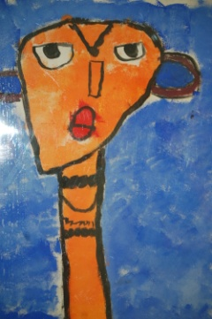
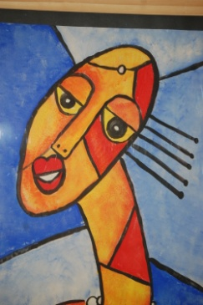
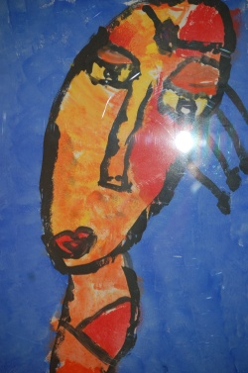
Future House Open Evening
10 December 2014
Special Joint Award Winner
Year 4 Pupils at St Cuthbert & The First Martyrs’ Catholic Primary School
‘African Portrait Work’

Slide 9
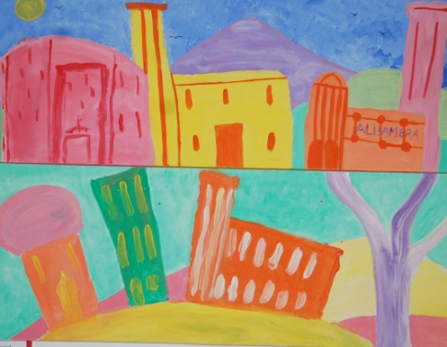
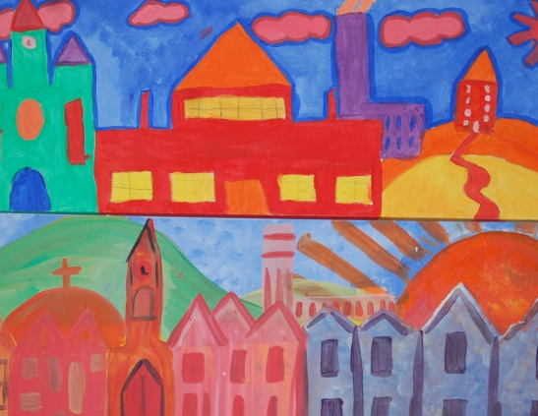
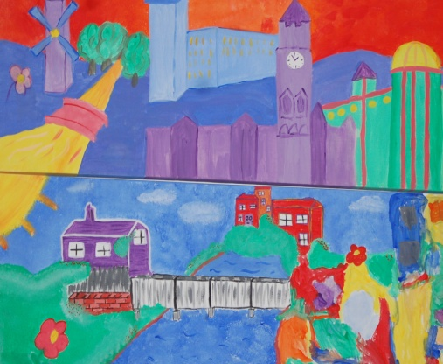
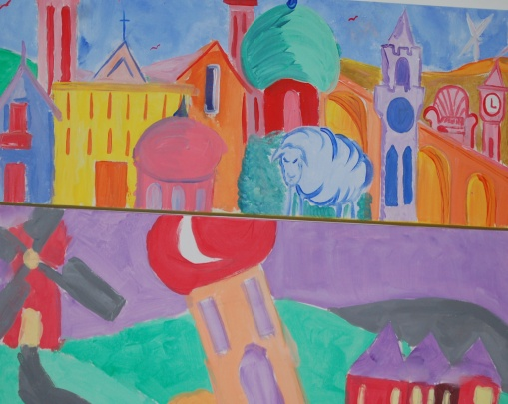
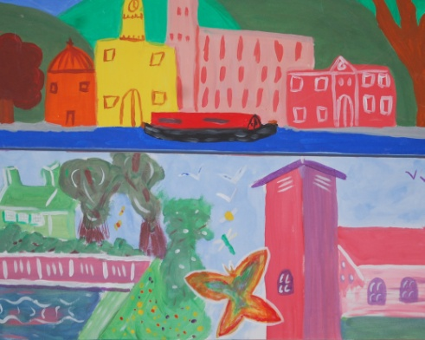
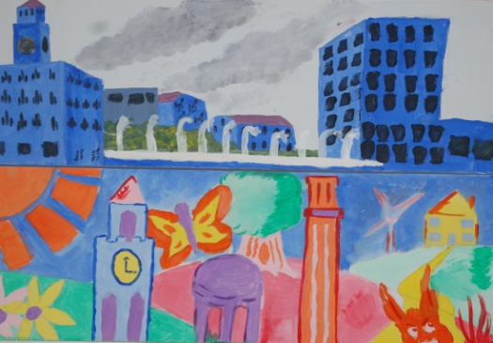
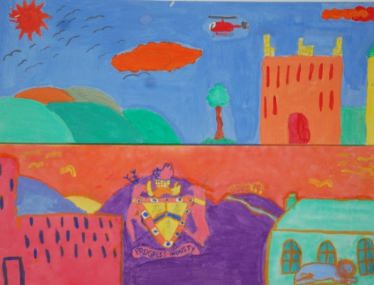
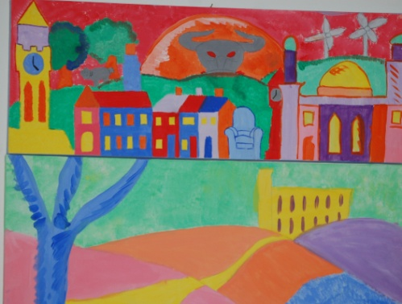
Future House Open Evening
10 December 2014
Special Joint Award Winner
Parkland Primary School
Parent & Child Group
‘Bradford District Landscapes’

Slide 10
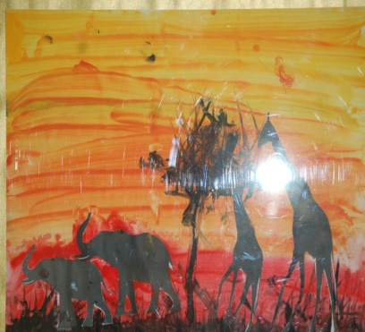
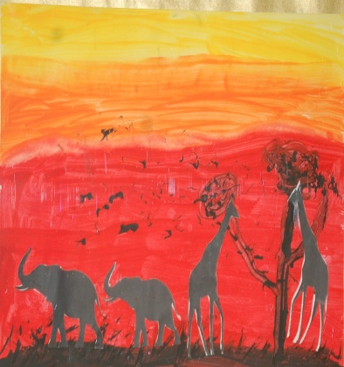
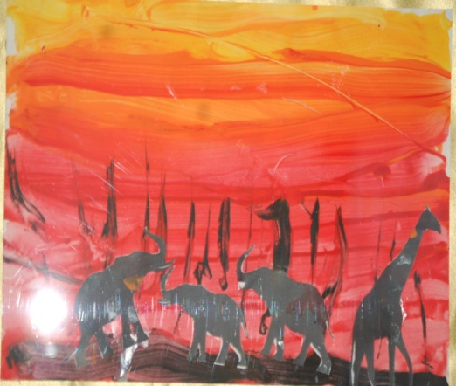
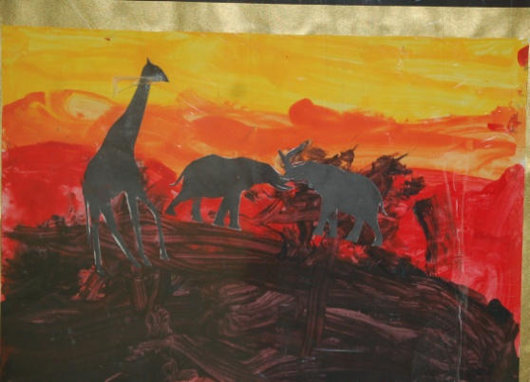
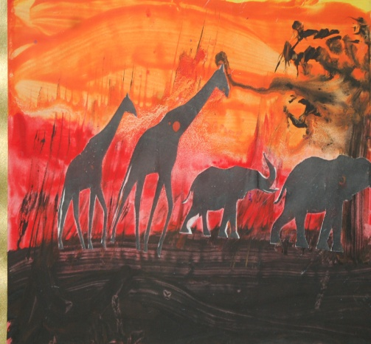
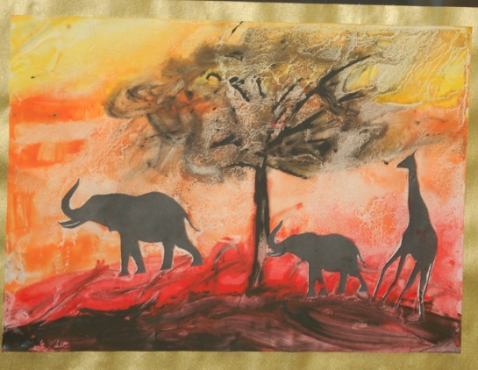
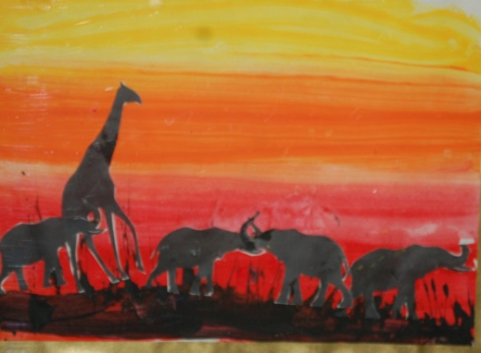
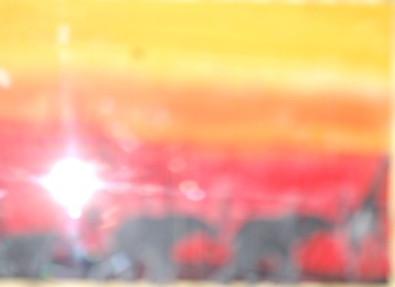
Future House Open Evening
10 December 2014
Special Joint Award Winner
Year 1 Pupils at Thorpe Primary School
‘African Landscapes’

Slide 11
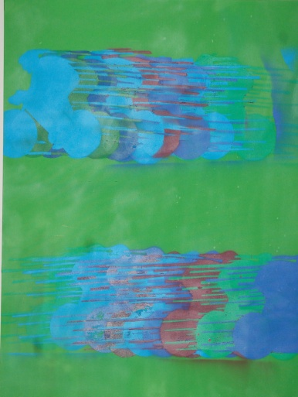
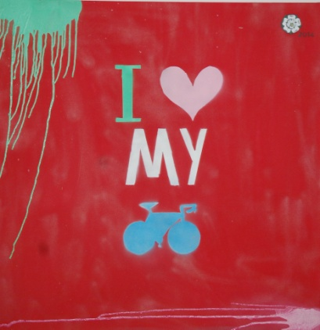
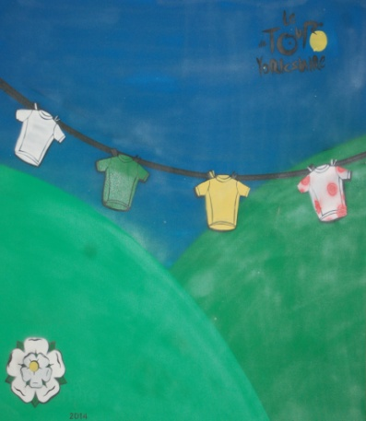
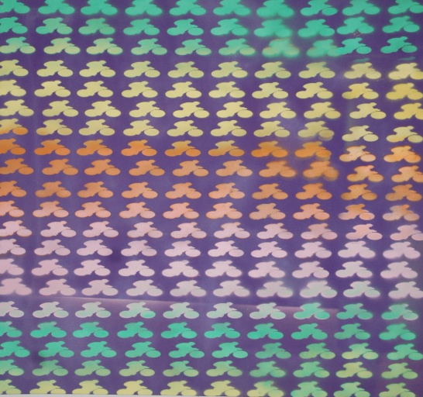
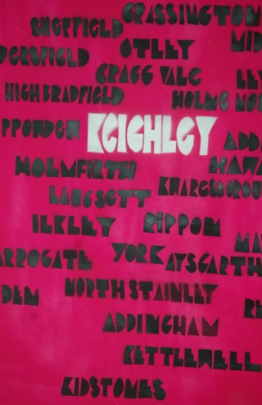
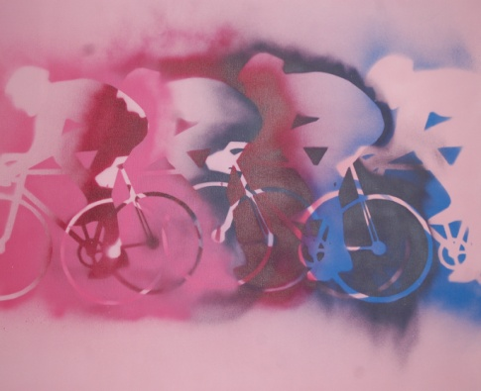
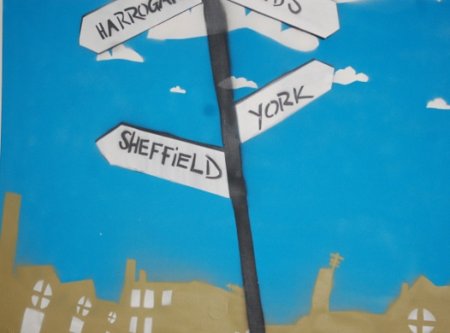
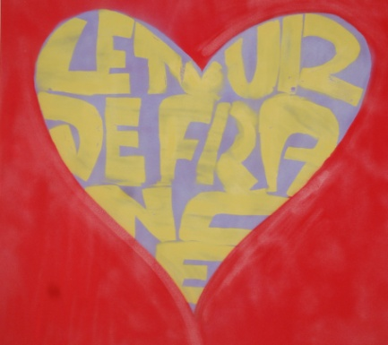
Future House Open Evening
10 December 2014
Special Joint Award Winner
Dixons Allerton Academy with Artist Mike Grainger
‘Tour de France’

Slide 12
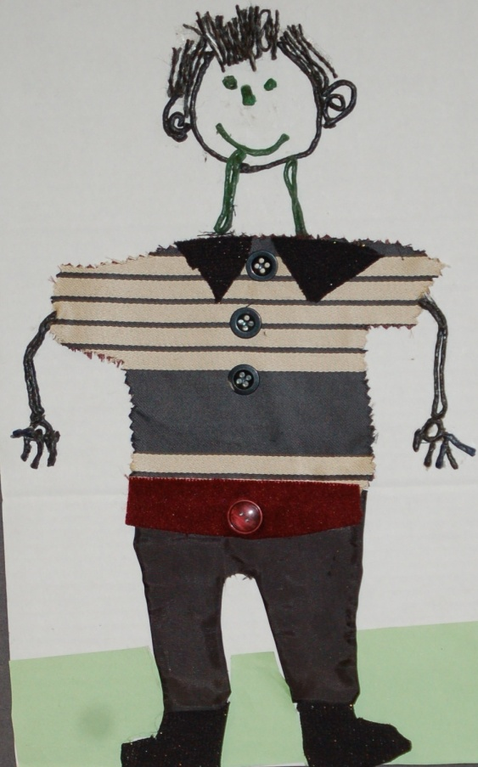
Future House Open Evening
10 December 2014
Visual Impaired Award
Abdur Khan of Hanson Academy Resource Base

Slide 13
Future House Open Evening
10 December 2014
Seasonal Greeting Card Competition 2014
Lord Mayor’s Choice
Isama Shah, Year 5 Lidget Green Primary School

Slide 14
Future House Open Evening
10 December 2014
1 - Zak Benitez
2 - Burnhanuddin Qureshi
3 - Ibrahim Akram
4 - Musa Majid
Reception Class
St Cuthbert & The First Martyrs’ Catholic Primary School
1
2
3
4
Seasonal Greeting Card Competition 2014
Leader of The Council’s Choice

Slide 15
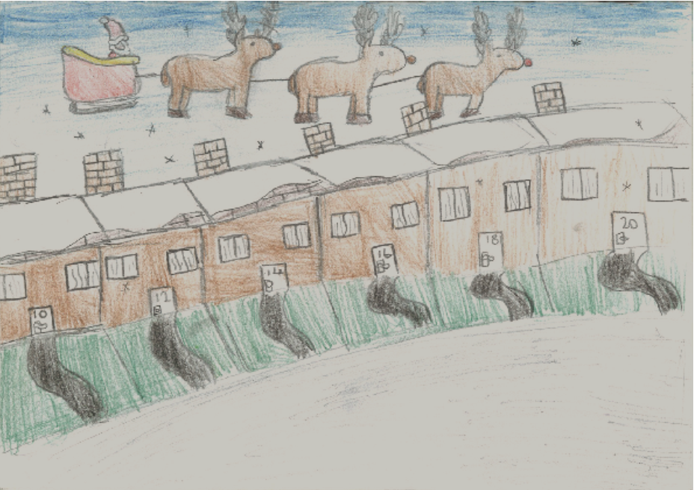
Future House Open Evening
10 December 2014
Seasonal Greeting Card Competition 2014
Department of Children’s Services Choice
Rema Ahmed, Year 6 of Feversham Primary School

Slide 16
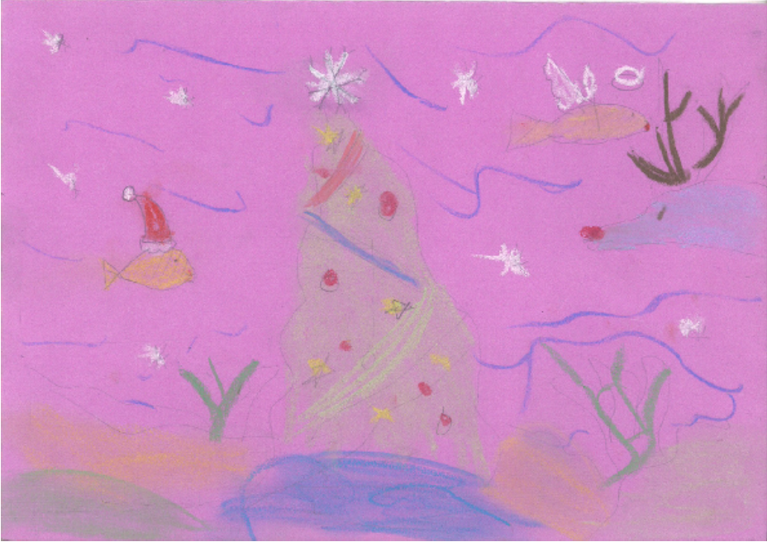
Future House Open Evening
10 December 2014
Seasonal Greeting Card Competition 2014
KS2 Runner Up
Lucy Poole, Year 4 of St Anthony’s Catholic Primary Clayton

Slide 17
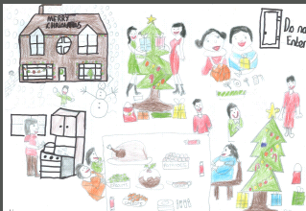
Future House Open Evening
10 December 2014
Seasonal Greeting Card Competition 2014
KS2 Runner Up
Harvinder Rehalu, Year 6 of Poplars Farm Primary School

Slide 18
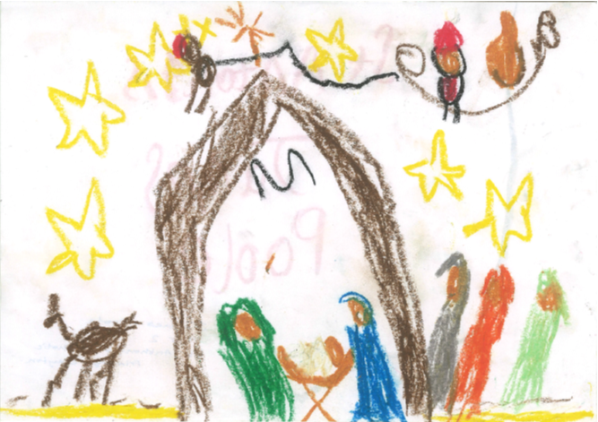
Future House Open Evening
10 December 2014
Seasonal Greeting Card Competition 2014
KS1 Runner Up
James Poole, Year 2 of St Anthony’s Catholic Primary Clayton

