Slide 1
Secondary Network Meeting
Thursday 26th January 2017
AGENDA
Buyback and School Budgets (Tony Johnson)
Assessment/progress tracking (open discussion)
Misswardmusic.com (C Ward)
Singing Strategy
Up and coming events
AOB
@BradfordSecondaryMusicNetwork

Slide 2
Buy Back and School’s Budgets
(Tony Johnson)

Slide 4
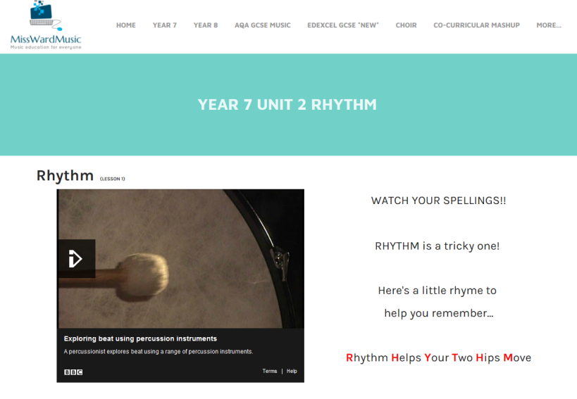
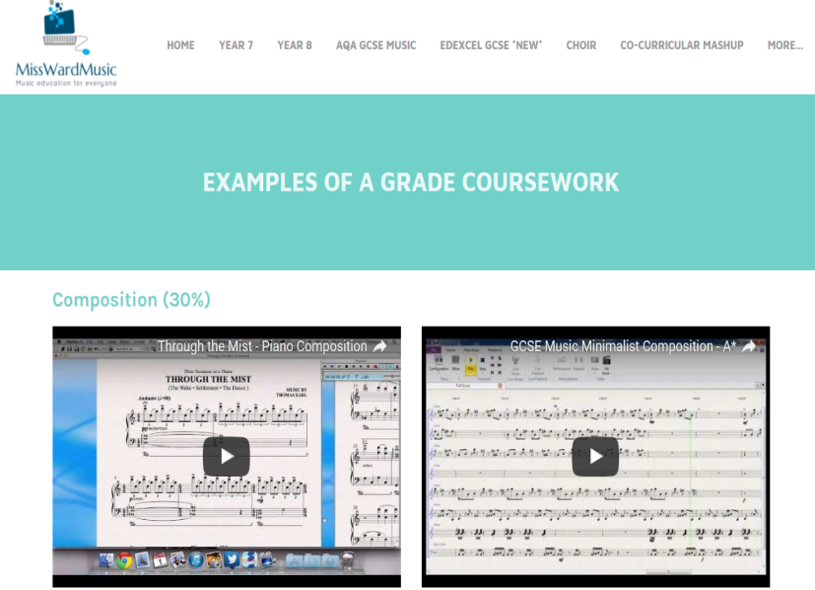
Misswardmusic.com

Slide 5
Assessment
(open discussion)

Slide 6
Singing Strategy
Re-launch September 2017
Special offers for schools
CPD opportunities
Multiple workshops and performances
Reform Singing Champions network
Links to primary
Peer network across secondary phase

Slide 7
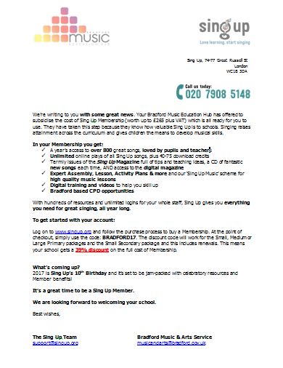
Sing Up Membership
Bradford Music Education Hub is working with Sing Up to:
Part fund Sing Up membership
Offering a 39% discount to ALL Bradford Schools (Max £150 small membership will cost £91.50 ex VAT, depending on school size)
Provide Bradford based CPD opportunities
Quote BRADFORD17 when joining/renewing to automatically receive your discount.

Slide 8
All Star Entertainment
Bradford Music Education Hub is working in collaboration with All Star Entertainment. They are offering:
Free Music/Music Tech/DJ Skills workshops in Bradford Secondary Schools
Bronze Arts Awards as a part of the workshop structure at no cost
Links to GCSE and BTEC courses
Contact Ross at All Star Entertainment on:
07758 219744
ross@allstarents.co.uk

Slide 9
Future Events
Introduction to BTEC Music Level 2
Monday 3rd July , 9:00am -2:30pm
Belle Vue Girls School
Tom Howell
Content of the day
Qualification Overview and Planning Your Course.
Internal and External Assessment Procedure.
The Quality Assurance Process.
An opportunity to see a Year 10 BTEC Music lesson in action and meet a student panel to gauge first hand pupil experiences.

Slide 10
Future Events
Council Choir
Mondays 4:30pm -6:00pm at City Hall, Bradford
Directed by Beccy Owen
On the following dates:
2017 Council Choir Dates:
12 June
3rd July
Sharing performance on 3rd July @5:30pm
@BradfordSecondaryMusicNetwork

Slide 11
Future Events
BBC Music Day (The Power Of Music)
City Park, Bradford.
Thursday 15th June (new date)
Big Sing/Dance workshops
World record Attempt
Multiple workshops and performances
FREE!
@BradfordSecondaryMusicNetwork

Slide 12
Future Events
Secondary Network Meeting:
Week commencing 16th October
Preferred date?
Volunteers to host…….?
Agenda items?
@BradfordSecondaryMusicNetwork

Slide 13
A.O.B
@BradfordSecondaryMusicNetwork

Slide 14
Useful websites
Copyright for Schools
http://www.copyrightandschools.org/
BBC Music Day resources:
https://www.bradfordmusiconline.co.uk/site/school-zone/online-resources/bbc-music-day-2017-resources/
Sing up Membership
https://www.singup.org/
Out of the Ark
http://www.outoftheark.co.uk/

