Slide 1
Secondary Network Meeting
Tuesday 18th June 2019
AGENDA
Introductions
Vocal network and opportunities
Music Coordinator E mails
Data Return
Exam Debrief (BTEC and GCSE)
Future Curriculum Planning
Furthering Talent Provision & Transition
Future events
AOB
BradfordSecondaryMusicNetwork

Slide 2
Vocal Network and Opportunities
Building Bradford’s Singing Strategy
Linking in-school vocal teachers
Building opportunities
Bradford District Youth Choir (in collaboration with vocal teachers)
BLAST! (continuation for events)
Anything else….!

Slide 3
Music Coordinator Emails
Which emails are useful?
Which emails are not?
Too many? Not enough? Just right?
Which ones do you take notice of?
Would a weekly/fortnightly newsletter be better?
Any other comments?

Slide 4
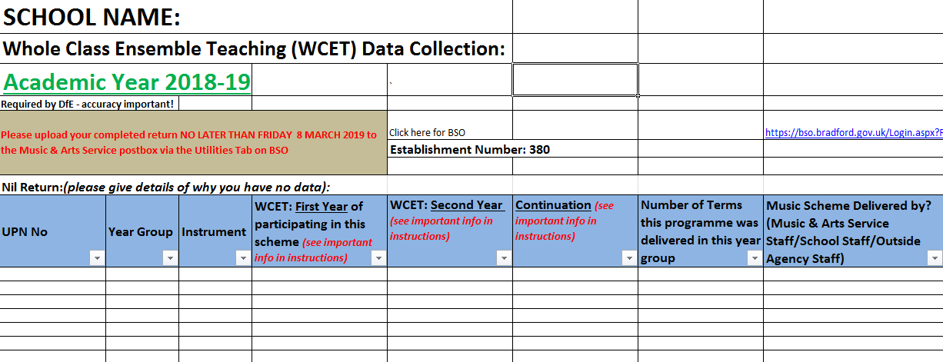
Arts Council Annual Data Return

Slide 5
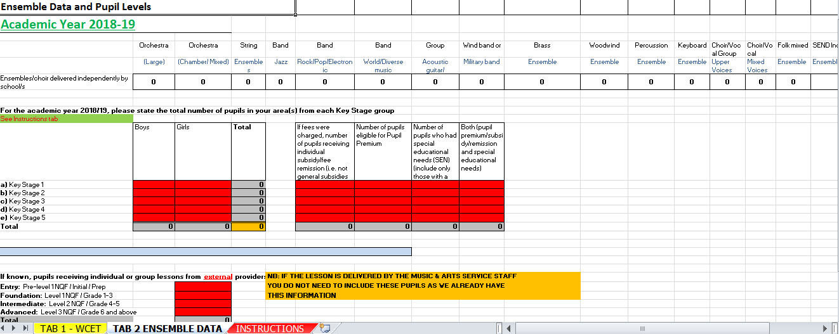

Slide 6
Music Mark Model Music Curriculum
https://www.musicmark.org.uk/wp-content/uploads/A-Music-Mark-Member-Consultation-Final-Paper.pdf

Slide 7
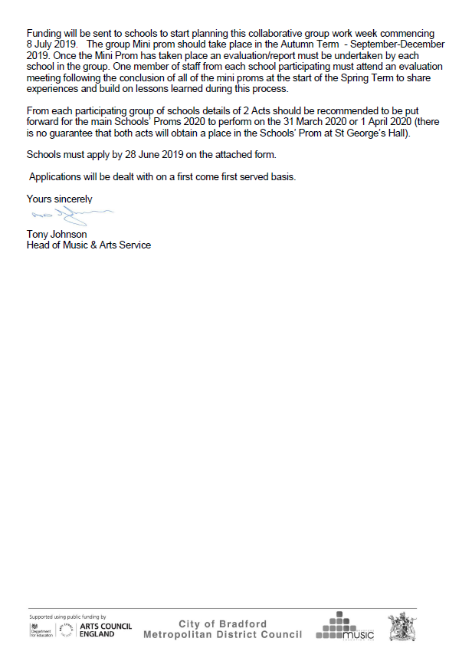
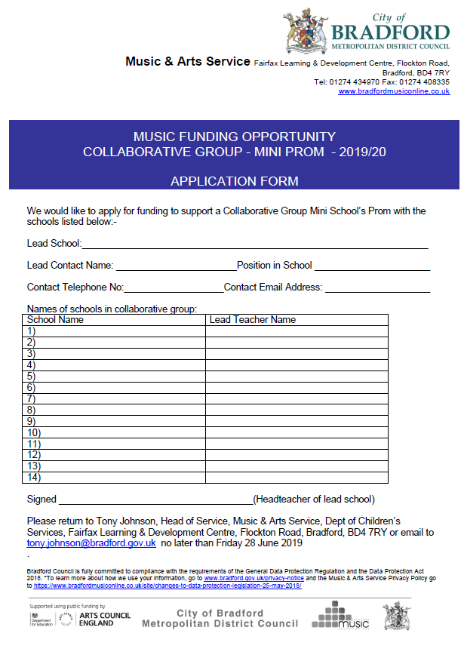
Funding Opportunity
Mini Prom 2019
(application form available on website)

Slide 8
Exam Debrief (BTEC & GCSE)
(open discussion)

Slide 9
Future Curriculum Planning
(open discussion)

Slide 10
Awards for Young Musicians
Further Talent

Slide 11
Event Updates – Autumn Term
Music Centre Concerts
Dates/venue tbc in autumn term
Bradford Youth Orchestra
Performing with Hammonds Brass Band
Date tbc
Christmas Festival
Bradford Cathedral
Tuesday 17th December

Slide 12
Future Events
Secondary Network Meetings:
W/C 21st October
Venue……..
Agenda items . . . . . . . .
Is after school still preferred?
Link to CPD?

Slide 13
A.O.B

