Slide 1
Shape Rhythms Display Slides
Bradford Music & Arts Service

Slide 3
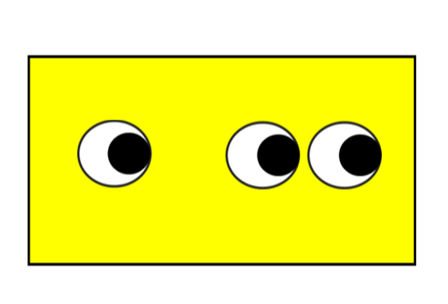

Slide 4
