Slide 1
Shape Rhythms Editable Slides
Bradford Music & Arts Service

Slide 2
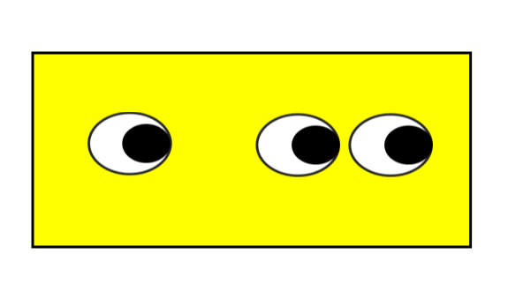
The shapes on this slide can be copied to create you own flash cards
and additional resources.

Slide 3
The notes and rhythms on this slide can be copied to create you own flash cards
and additional resources.

