Slide 1
Shape Rhythms
Bradford Music & Arts Service

Slide 3
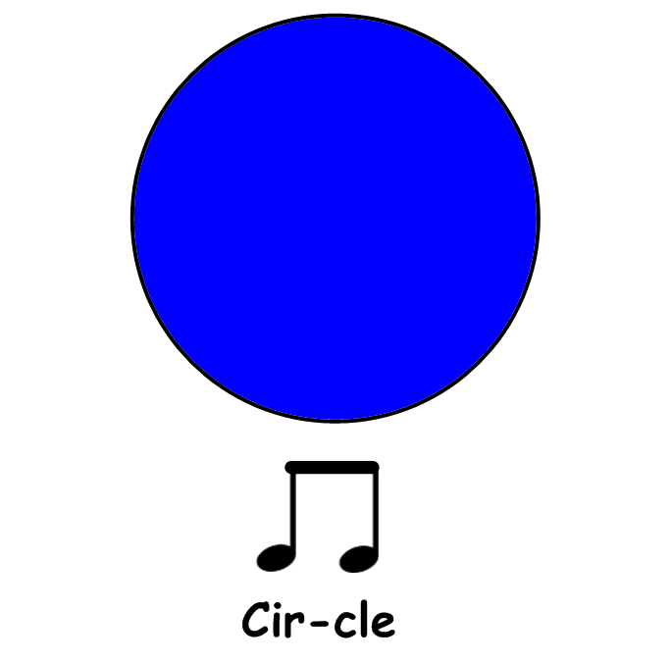

Slide 4
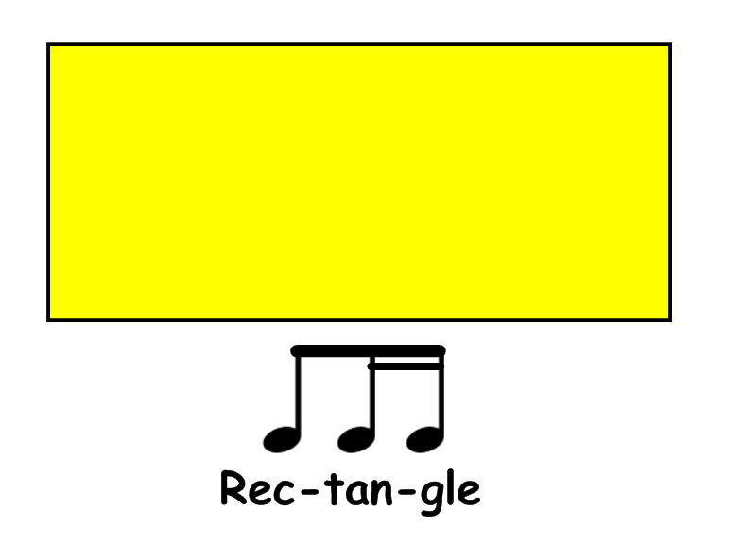

Slide 5
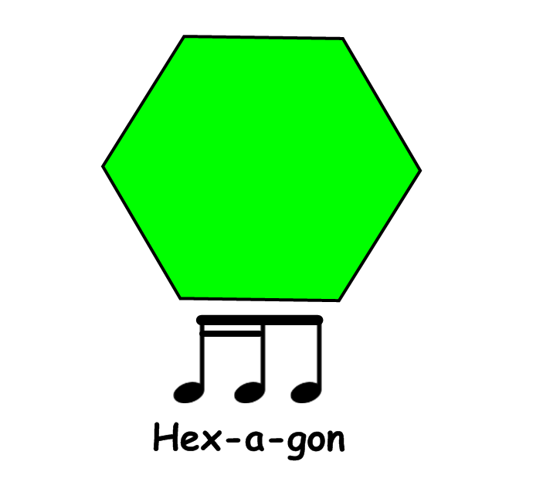

Slide 6
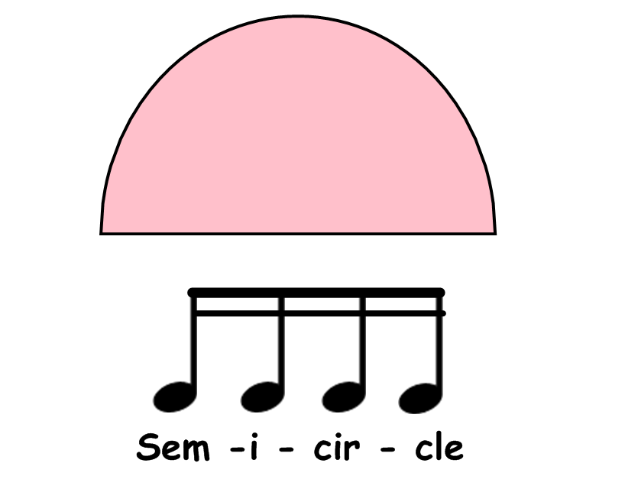

Slide 19
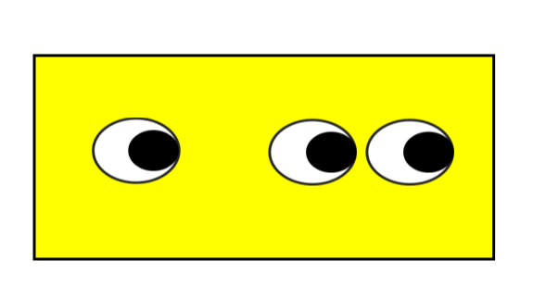

Slide 30
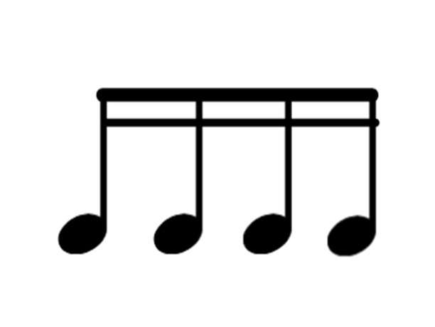

Slide 39
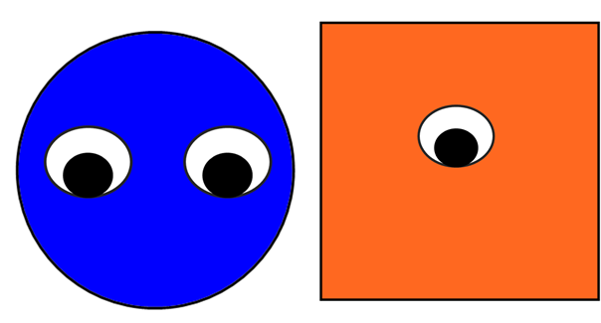

Slide 47
The shapes on this slide can be copied to create you own flash cards
and additional resources.

Slide 48
The notes and rhythms on this slide can be copied to create you own flash cards
and additional resources.

