Slide 1
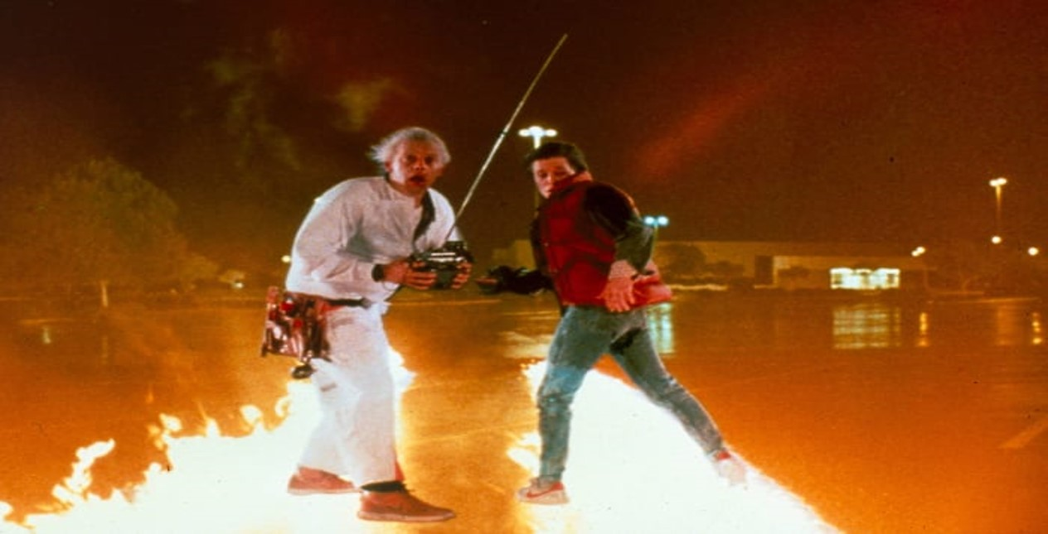

Slide 2
2026 THE FUTURE PRESTIGIOUS ART EXHIBITION FOR YOUR PUPILS
Opening Thursday 5 March 2026

Slide 3


Slide 4

TWO PARTS TO THE EXHIBITION

Slide 5

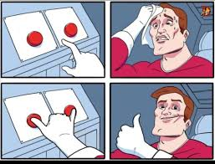
SCHOOLS ARE ASKED TO DO BOTH PARTS OF THE PROJECT NOT JUST ONE!

Slide 6
PART 1 - 2D “My / Our Future”

Slide 7
PART 1 - 2D “My / Our Future”
Schools are asked to produce one A1 piece designed to hang portrait. This could be a collaborative piece or a combined display of a number of pupils' work. Please use paper or thin card
The piece should answer the question, “what are my hopes and predictions for the future.”
This could be:
A simple collage of illustrated words
Illustrations of future worlds
Illustrations of the children aged in the future

Slide 8

PART 1 - 2D “My / Our Future”
Staff and pupils are invited to interpret this brief in any way they want, the suggestions are not an exhaustive list
You could link it with a study of an established artist
Your choice of medium is entirely up to you but try to ensure it is original and eye catching

Slide 9
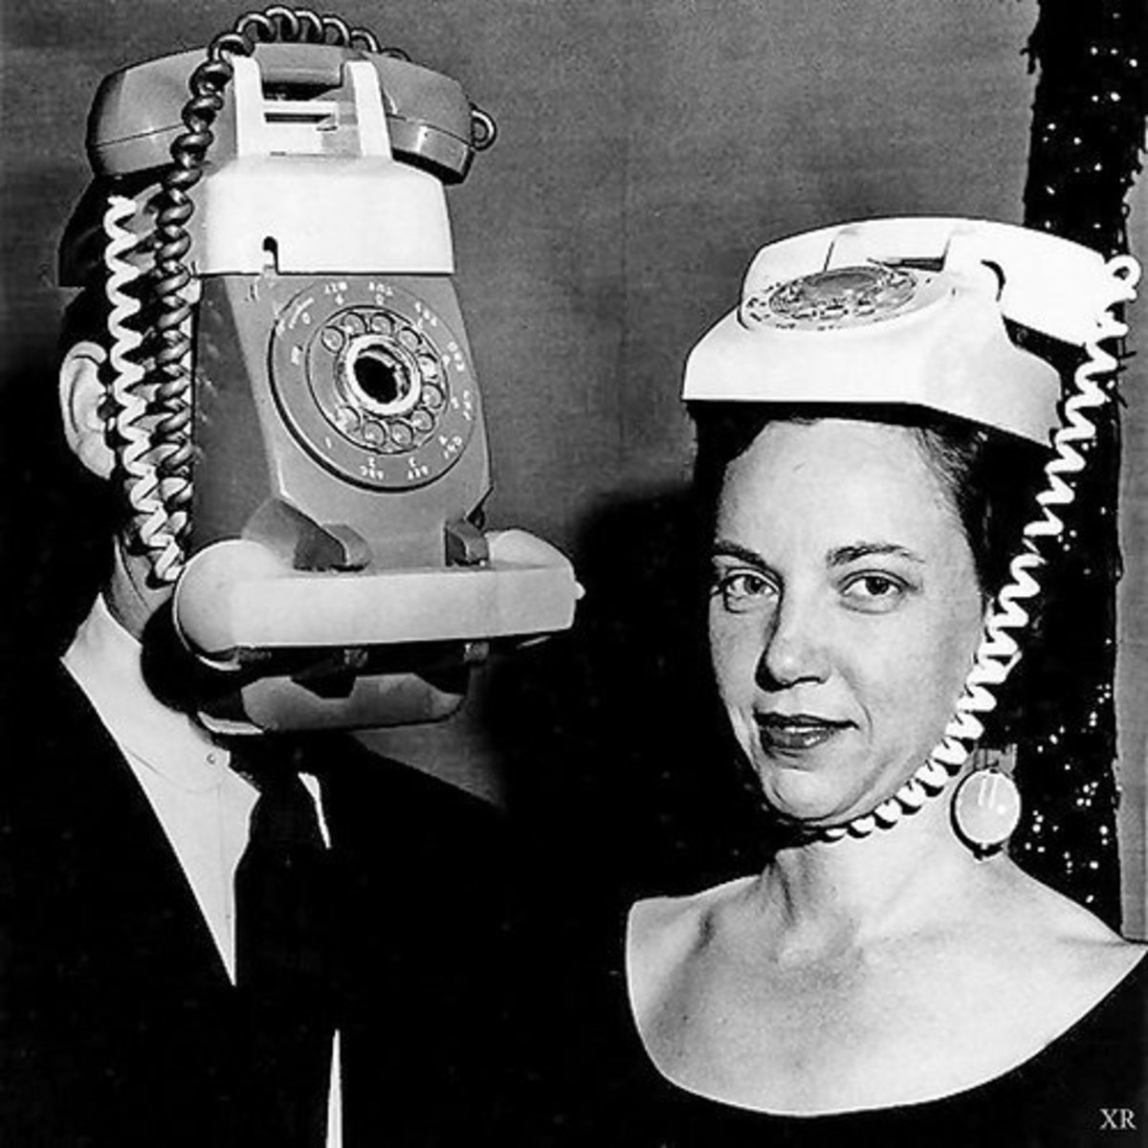
PART 2 - 3D MODEL Choice of two options
Whichever option you choose, please follow the dimensions below
This must be a standard size of 45cm square. Schools are also asked to make their own stand - this could be as simple as 4 fold away legs or a sturdy box. This must be no taller than 90cm and no shorter than 60cm.
Please make this sturdy

Slide 10
OPTION 1 : An Invention for the Future

Slide 11

An Invention for the Future
Create a model of an invention for the future
Don’t worry, it doesn’t have to be a working model
Invite the children to think about what inventions would make life easier or just more fun
Pupils could include written explanations
The model could be made interactive

Slide 12
OPTION 2 : Buildings of the Future

Slide 13
Buildings of the Future
Create a model of a building of the future
You could create a complete city
You could reinvent an existing known building
You don’t have to restrict your self to planet Earth
Have you considered living under water?

Slide 14
SECONDARY SCHOOLS WELCOME
Though designed with younger pupils in mind we would welcome work from any school aged pupils .
Any questions please contact Tony on
anthony.bullock@bradford.gov.uk

Slide 15

CALENDAR OF KEY DATES
May – October 2025
Sign your school up to the exhibition
September 2025
Start project with staff and pupils
Monday 2 March 2026
Drop off at dye house gallery
Thursday 5 March 2026
Opening night at dye house gallery

Slide 16
SIGN UP NOW
Click on link below to sign up
Please provide emails of all relevant staff and the general school email.
https://www.bradfordmusiconline.co.uk/site/art-events/

Slide 17
OTHER ARTS ISSUES 2025–26

Slide 18
OTHER ARTS ISSUES 2025-26
Ensure your Art contact is up-to-date by completing the GDPR form
Christmas card competition deadline - always last Wednesday before October half term. Electronic submission only. 22 October 2025
Eid card competition deadline - always last Wednesday before February half term. Electronic submission only. 11 FEBRUARY 2026
Free arts courses available for staff starting, see website

