Slide 1





Slide 2


Welcome!
Photographs, Videos and Social Media.
Workshop information (see badge)
Hawksworth (Main Room)
Haworth (end of dining room)
Thompson (upstairs)
Copper Beech (upstairs)
Bronte (upstairs and follow the corridor)
Please remember to return your badges before you leave at the end of the day!

Slide 3
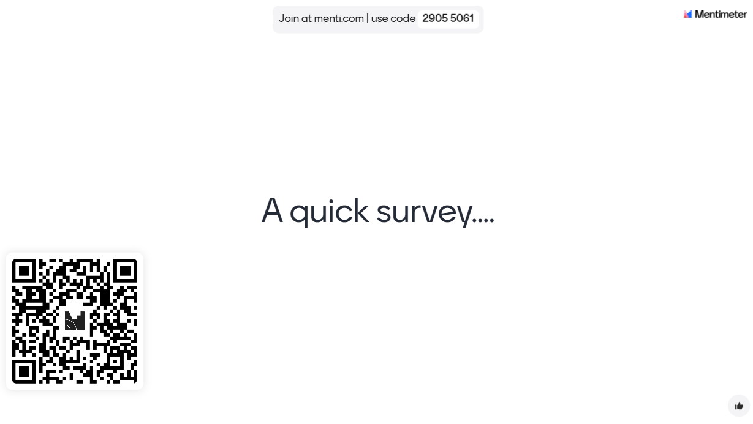


Slide 4
Running Order
8.30 am Registrations and Refreshments
9.00 am Welcome/Introduction: Carl White - Head of Music & Arts Service
9.10 am Big Sing! Ben Lawrence
9.30 am Keynote Speaker: Sam Stimpson SLS 360
10.20 am Break
10.35am Workshop 1
11.35am BD2025 Team Update
12.00pm Lunch and chat
1:00pm West Yorkshire Music Hub – Carl White
1.30pm Workshop 2
2.30pm Break
2.50pm Workshop 3
3.50pm Plenary

Slide 5


Strategic and wider responsibilities
www.westyorkshiremusichub.org.uk
What to watch for in 2025:
West Yorkshire Musical Inclusion Strategy
Lead Schools

Slide 6
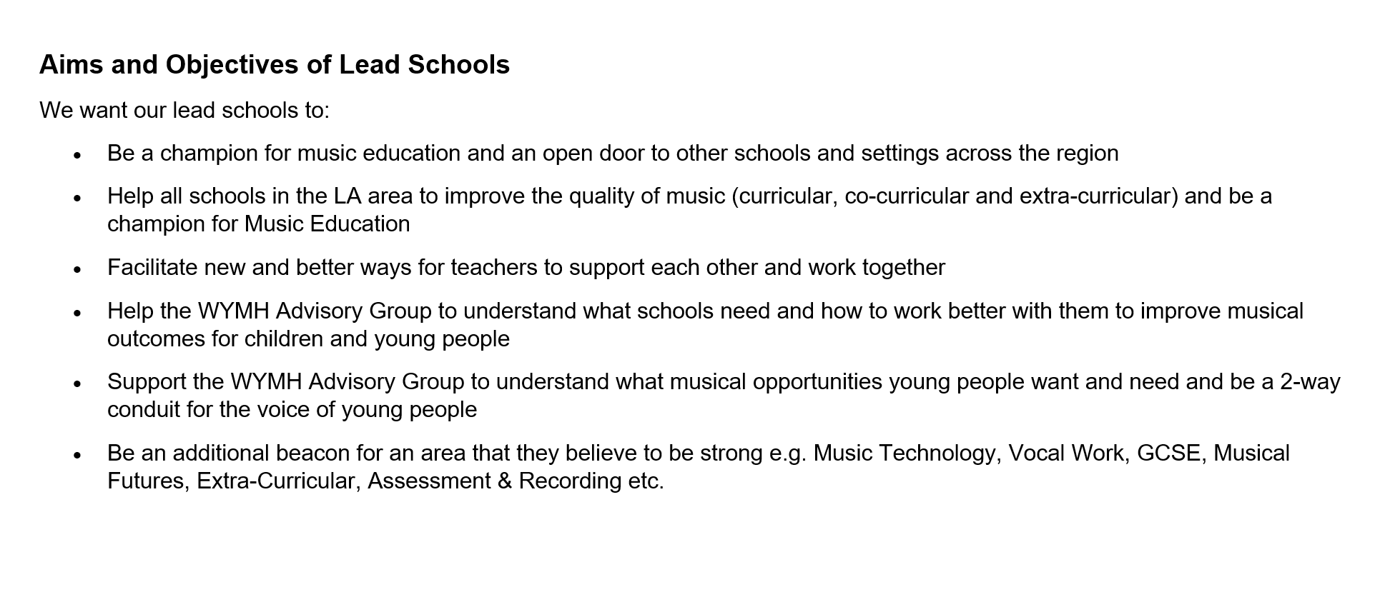

Slide 7
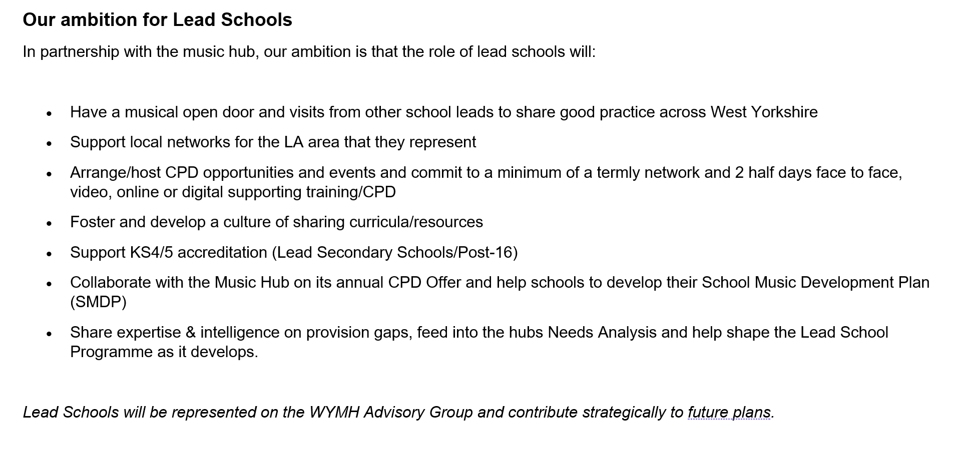

Slide 8
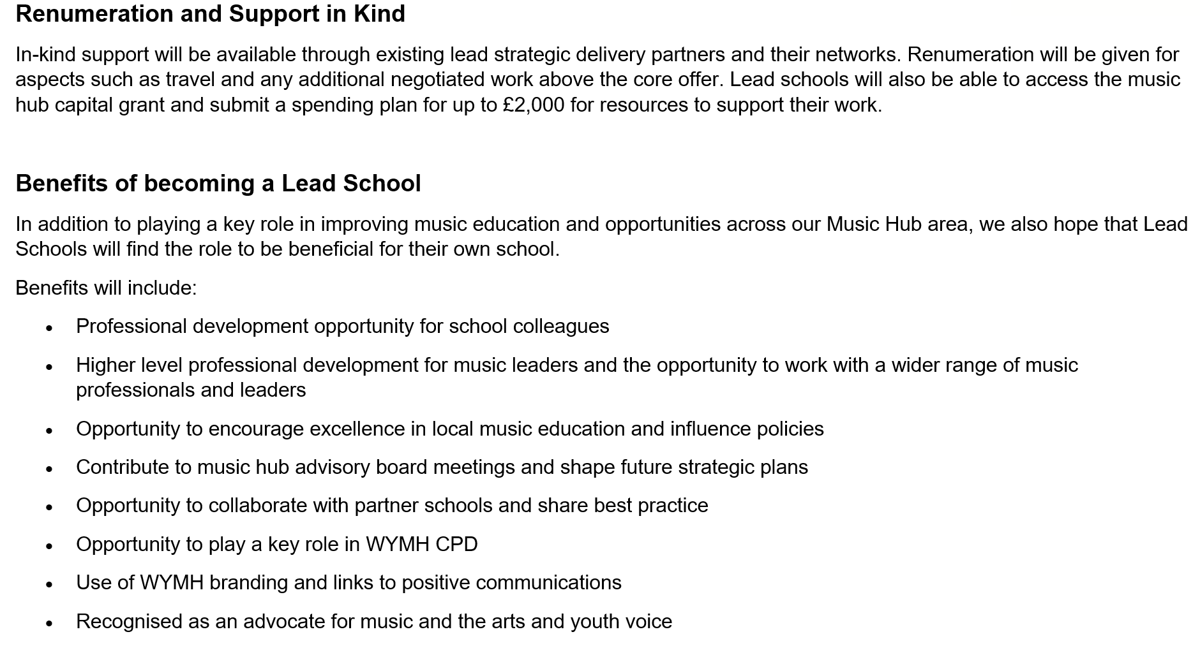

Slide 9
Lead schools overview – what are we looking for?
Must be passionate about music!
Champion music education
Be clear about how you might help schools across the Bradford & West Yorkshire improve the quality of music
Work with the West Yorkshire Hub Advisory Group and collaborate with the Music Hub and schools across West Yorkshire
Be recognised as an advocate for music, the arts and youth voice
£2000 Capital Grant funding in the first year to purchase instruments/technology for music
Initially 1 year but we are looking for a 3-year commitment
2 x half days plus termly Network meetings
Application form deadline - Wednesday 26th February 4pm. Submit to WYMH@bradford.gov.uk

Slide 10
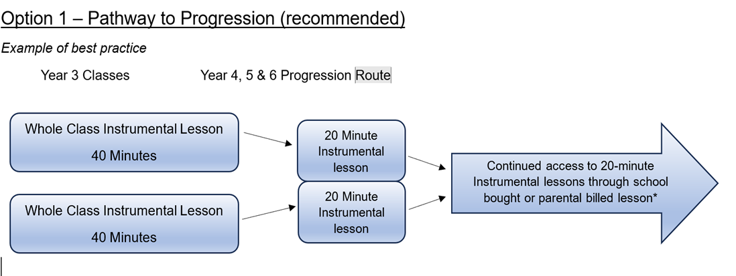


Buy Back 2025-26

Slide 11
Buy Back 2025-26
Two Billing Methods
School Billed (very useful for supporting pupils e.g. Pupil Premium)
Direct / Parental Billed
Small group and individual instrumental lessons are available on:
GUITAR & PERCUSSION BRASS WOODWIND STRINGS
Guitar (electric & acoustic) Trumpet/cornet Flute Violin
Ukulele French Horn/Tenor Horn Oboe/Bassoon Viola
Bass Trombone Clarinet/Bass Clarinet Cello
Drum Kit Baritone/Euphonium Alto/Tenor/Bari Sax Double Bass
Percussion Tuba
KEYBOARD VOICE
Piano All Voices types and range of genres
Keyboard
Support available for instrumental loan and (see remissions policy)
Wide range of bands/orchestras/choirs
Support for LAC/PP/FSM/etc (see remissions policy)

Slide 12
Lead Schools Information:
To download the form:
https://www.bradfordmusiconline.co.uk/site/wymh-lead-schools/
Please email your completed form to wymh@bradford.gov.uk by Wednesday 26th February 4pm.
Please direct any specific questions or queries to Phil Needham – Responsible for Schools engagement as part of the West Yorkshire Music Hub pneedham@wakefield.gov.uk

